Slide 1
British Green

Slide 2
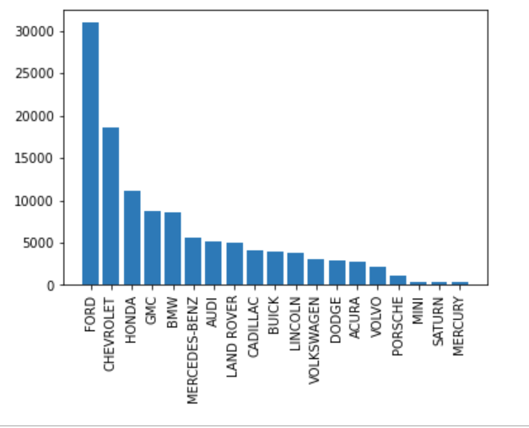
This is showing the correlation between brand name and price

Slide 3
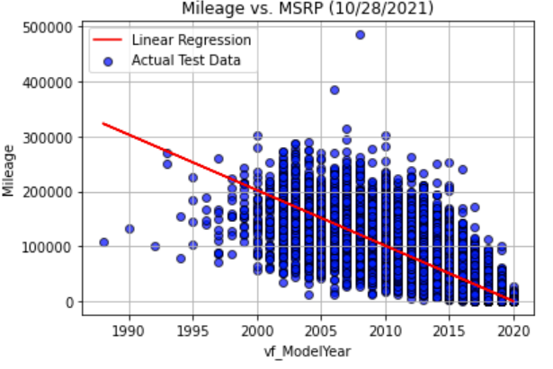
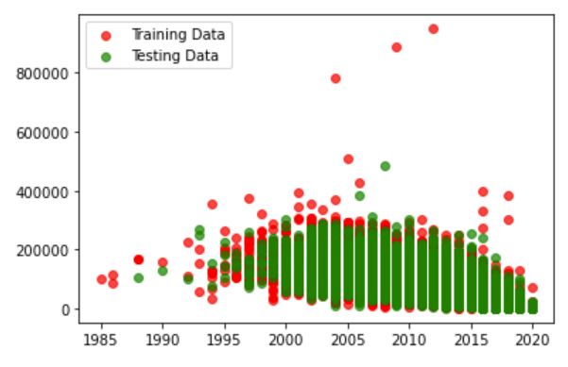
Correlation of Model Year and Mileage

Slide 4
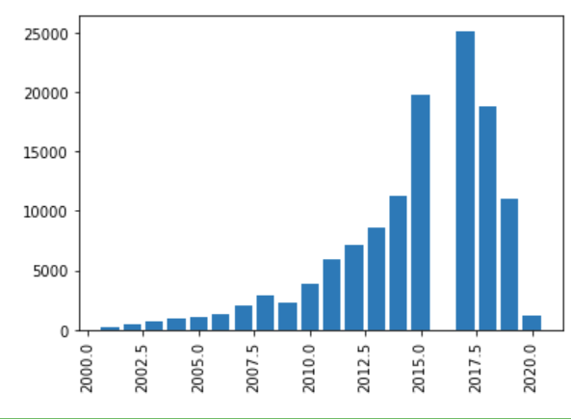
Correlation of Mileage and Year

